Slide 1
CRI3I3 Pemrograman Perangkat Bergerak
Intro Dart

Slide 2
Dart
Dart is an open-source general-purpose programming language. It is originally developed by Google and later approved as a standard by ECMA
Dart is an object-oriented language with C-style syntax which can optionally trans compile into JavaScript
Dart can be used for the server as well as the browser

Slide 3
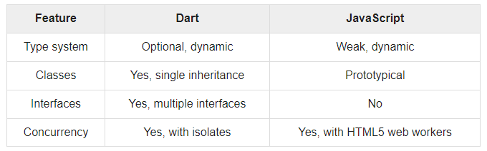
Difference between Dart and Javascript

Slide 4
Variables & Data Types
Rules of naming
Case sensitive
Start with a letter or underscore
Must not a Dart’s reserved word
Must not contains operational characters
Variable declaration
var namevariable = value;
<type> namevariable = value;
Data types:
Standard (bool, int, double, String)
List
Map
Enum
Dynamic

Slide 5
Example: standard data types
bool flag = true; (boolean)
unlike Javascript, only true value is considered a true condition
int i = 2; (integer)
double j = 2.3; (double)
String name1 = "double"; (string double quote)
String name2 = 'single'; (string single quote)

Slide 6
Code commenting
Same with C++ / Java / PHP
// one line
/* ..
multi-line
.. */

Slide 7
Example: List
Initialization
//fixed length
var L1 = new List(5);
//growable list
var L2 = new List(); //or,
var L3 = []; //or,
var L4 = ["IF", "IT", "SE"];
Call
print(L4[0]); //output: IF
print(L3[1]); //output: Exception

Slide 8
Example: List
Assignment
L2[0] = "S2 IF";
L3.add("S3 IF");

Slide 9
Example: Map
Initialization
var M2 = new Map(); //or,
var M3 = {}; //or,
var M4 = {"IF":1301, "IT":1303, "SE":1302};
Call
print(M4['IF']); //output: 1301
print(M3[1]); //output: null

Slide 10
Example: Map
Assignment
M4["S2 IF"] = 2301;
M3.addAll({"S3 IF":3301});

Slide 11
Example: Enum
Initialization
enum Status {
none,
running,
stopped,
paused
}
Call
print(Status.values[1]); //output: running

Slide 12
Operator
Arithmetic: + - * / ~/ % ++ --
Assignment : = ??= += -= *= /=
Comparison : == != > < >= <=
Logical: && || !
Type test: is !is
Conditional:
condition ? expr1 : expr2
expr1 ?? expr2

Slide 13
Conditional (if)
Example:
var i = 1;
if (i>0) {
print("$i = positive number");
}

Slide 14
Conditional (if-else)
Example:
var i = -8;
if (i>0) {
print("positive");
} else if (i==0) {
print("zero");
} else {
print("negative");
}

Slide 15
Conditional (switch-case)
Example:
var bil=5;
switch (bil) {
case 0 :
print("zero");
break;
case 2 :
print("two");
break;
default :
print("other");
}

Slide 16
Looping (while)
Example:
var i=0;
while (i<4) {
print("loop $i");
i++;
}

Slide 17
Looping (do-while)
Example:
var i=0;
do {
print("loop $i");
i++;
} while (i<8);

Slide 18
Looping (for)
Example:
for (var i=1;i<7;i++) {
print("heading $i");
}

Slide 19
Looping (for in)
Example:
var obj = [12,13,14];
for (var prop in obj) {
print(prop);
}

Slide 20
Function
Dart function is not similar to Javascript function:
Just the function name
Begins with keyword void if function doesn’t return value
Can be declared with Lambda

Slide 21
Function
Example:
//function declaration
void sayhello(str) {
print("hello $str");
}
add(a,b) {
return a+b;
}
sayHi(n)=>print("hi $n!");

Slide 22
Function
Example:
//function execution
sayhello("bro!");
var x = add(5,6);
print("$x + 3 = " + add(x,3).toString());
sayHi('Dart');

Slide 23
Class
Structure:
class class_name {
<fields>
<getters/setters>
<constructors>
<functions>
}
Execution:
var object_name = new class_name([ arguments ])

Slide 24
Constructor
Similar like Java:
class class_name {
class_name([arguments]) {
//..
}
//named constructor
class_name.constructor_name([arguments]) {
//..
}
}

Slide 25
Getter and Setter
Structure:
class class_name {
//getter
return_type get function_name {
//..
}
//setter
set function_name {
//..
}
}

Slide 26
Sync Process
In computing, we say something is synchronous when it waits for an event to happen before continuing.
A disadvantage in this approach is that if a part of the code takes too long to execute, the subsequent blocks, though unrelated, will be blocked from executing.
Consider a webserver that must respond to multiple requests for a resource

Slide 27
Sync Process
A synchronous execution model will block every other user’s request till it finishes processing the current request. In such a case, like that of a web server, every request must be independent of the others.
This means, the webserver should not wait for the current request to finish executing before it responds to request from other users.
Simply put, it should accept requests from new users before necessarily completing the requests of previous users. This is termed as asynchronous.

Slide 28
Async
Asynchronous programming basically means no waiting or non-blocking programming model
An asynchronous operation executes in a thread, separate from the main application thread
When an application calls a method to perform an operation asynchronously, the application can continue executing while the asynchronous method performs its task

Slide 29
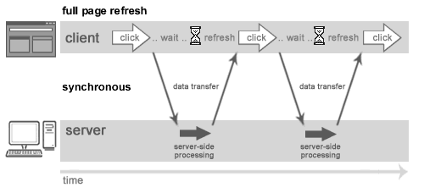
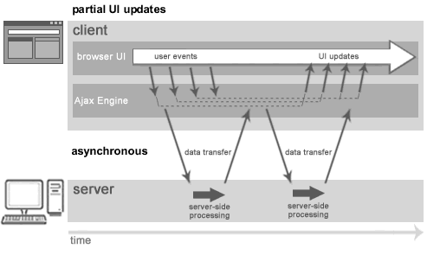
Understanding Synchronous vs Asynchronous
Synchronous (Classic Web-Application Model)
Asynchronous (AJAX/API Web-Application Model)

Slide 30
Future
a Future as "a means for getting a value sometime in the future." Simply put, Future objects are a mechanism to represent values returned by an expression whose execution will complete at a later point in time.
Several of Dart’s built-in classes return a Future when an asynchronous method is called.
Dart is a single-threaded programming language. If any code blocks the thread of execution (for example, by waiting for a time-consuming operation or blocking on I/O), the program effectively freezes.

Slide 31
Future
Asynchronous operations let your program run without getting blocked. Dart uses Future objects to represent asynchronous operations
Future<void> fetchData() async {
try {
List<Order> orders = await Cord.getAll();
//..
} catch(e) {
//..
}
}

Slide 32

Any question?

Slide 33
References
https://dart.dev/
https://www.tutorialspoint.com/dart_programming/index.htm

